Slide 1
THE BASICS OF TEXT ANALYSIS: TOPIC MODELING AND WORD EMBEDDINGS
Keith Burghardt
DSCI 531 – Spring 2024
February 21, 2024

Slide 2
Why text analysis
Volume of text data is growing exponentially, necessitating methods for automatically organizing, understanding, searching and summarizing them
Uncover hidden topical patterns in collections.
Annotate documents according to topics.
Using annotations to organize, summarize and search.
Generate fluent and grammatical text.

Slide 3


What is NLP?
How computers understand language
Audio
Visual
Text
Critical to understand text at scale

Slide 4
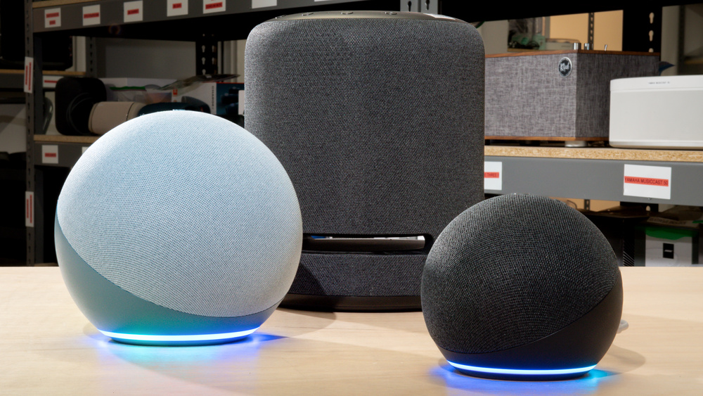

NLP examples
Convert X to text
Speech recognition
Optical character recognition
”Words get a vector, docs get a vector everything gets a vector”

Slide 5

NLP examples
“This is an example sentence about parsing” ->
“This”
“Example”
”Parsing”
…
This: Adverb Is: Verb (linking) Example: Adjective Sentence: Noun (object of preposition)
…
Parse language
Speech segmentation:
Extract text features
Text-to-speech

Slide 6
Low-level text analysis

Slide 7
Understanding text: low level features
“Parse language, Speech segmentation, Extract text features, text to speech: “ {'neg': 0.0, 'neu': 1.0, 'pos': 0.0, 'compound': 0.0}
Sentiment/emotion extraction
Named entity recognition
Hate speech detection
…
“I threw the ball to Keith in June 1” Keith: Person June 1: Time
“I threw the ball to Keith in June 1” Hate speech confidence: 0.0

Slide 8
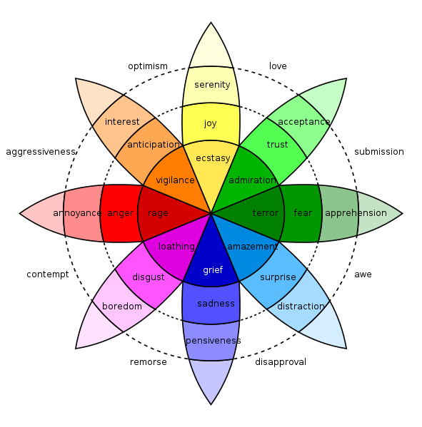
Case study: measuring emotion in language
Emotions are psychological states brought on by thoughts, feelings, behavioural responses, and a degree of pleasure or displeasure.
E.g., happiness, sadness, surprise, disgust, anger, and fear.
Positive & negative emotions
Can we predict them from text?

Slide 9
Dictionary-based Sentiment Analysis
LIWC: dictionary approach
Words annotated with over 80 psychological categories, including positive and negative sentiment
WKB lexicon
14,000 English words annotated with emotional valence (positivity/negativity) and arousal (strength of emotion).
Also exists in Spanish
SentiStrength
Positive and negative sentiment
Vader
Valence Aware Dictionary for sEntiment Reasoning

Slide 10
Warriner’s (WKB) lexicon
Sentiment lexicon
Three dimensions of emotion
Valence
Arousal
Dominance
Collected emotional ratings for 14,000 words, the majority of the well-known English content words
Participants recruited through Amazon Mechanical Turk
shown lists of 350 words, including 10 calibrator words
asked to rate each word along 3 dimensions using a 9 pt scale
[Wariner et el., (2013) “Norms of valence, arousal, and dominance for 13,915 English lemmas”, ]

Slide 11
How do you feel while reading each word?
Valence
9: Happy, pleased, satisfied, contented, hopeful
1: Unhappy, annoyed, melancholic, despaired, or bored
Arousal
9: Excited, stimulated, excited, frenzied, jittery, wide-awake
1: Calm, relaxed, sluggish, dull, sleepy, or unaroused
5: Neutral, neither happy nor sad [not excited nor at all calm; neither in control nor controlled]

Slide 12
 | Valence |  | Arousal |  | Dominance
Lowest | pedophile | 1.26 | grain | 1.60 | dementia | 1.68
 | rapist | 1.30 | dull | 1.67 | Alzheimer’s | 2.00
 | AIDS | 1.33 | calm | 1.67 | lobotomy | 2.00
 | leukemia | 1.47 | librarian | 1.75 | earthquake | 2.14
 | molester | 1.48 | soothing | 1.91 | uncontrollable | 2.18
 | murder | 1.48 | scene | 1.95 | rapist | 2.21
Highest | excited | 8.11 | motherfucker | 7.33 | rejoice | 7.68
 | sunshine | 8.14 | erection | 7.37 | successful | 7.71
 | relaxing | 8.19 | terrorism | 7.42 | smile | 7.72
 | lovable | 8.26 | lover | 7.45 | completion | 7.73
 | fantastic | 8.36 | rampage | 7.57 | self | 7.74
 | happiness | 8.48 | insanity | 7.79 | incredible | 7.74

Slide 13
VADER
gold-standard sentiment lexicon that is especially attuned to microblog-like contexts.
Rules for grammatical and syntactical conventions that humans use when expressing or emphasizing sentiment intensity
Performs well on social media posts (better than LIWC)

Slide 14
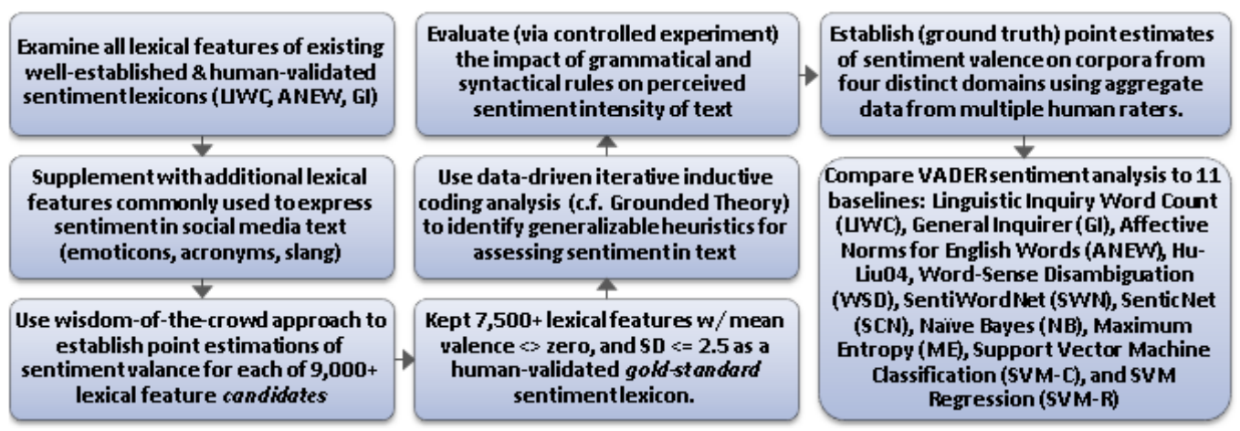
VADER

Slide 15
(LIWC) Application: Global Mood Patterns
“Diurnal and seasonal moods vary with work, sleep and daylength across diverse cultures” by Golder and Macy
Can automated sentiment analysis be applied to social media data to provide a global picture of human mood?
Does mood have a time scale? Seasonal patterns?
Data
Up to 400 public messages from each user, 509 million messages total
2.4 million individuals worldwide (84 identified countries)
English only
Date, Time, and country latitude

Slide 16
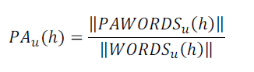
Methodology
Examined within-individual Positive Affect (PA) and Negative Affect (NA) independently,
E.g., fraction of PA words appearing in an individual’s messages every hour
To eliminate between-individual variation, subtract the mean: PA_{u}*(h) = PA_{u}(h) - <PA_{u}(h)>
Additional analysis on 4 English-speaking regions: Africa, India, UK/Aus, US/Can

Slide 17
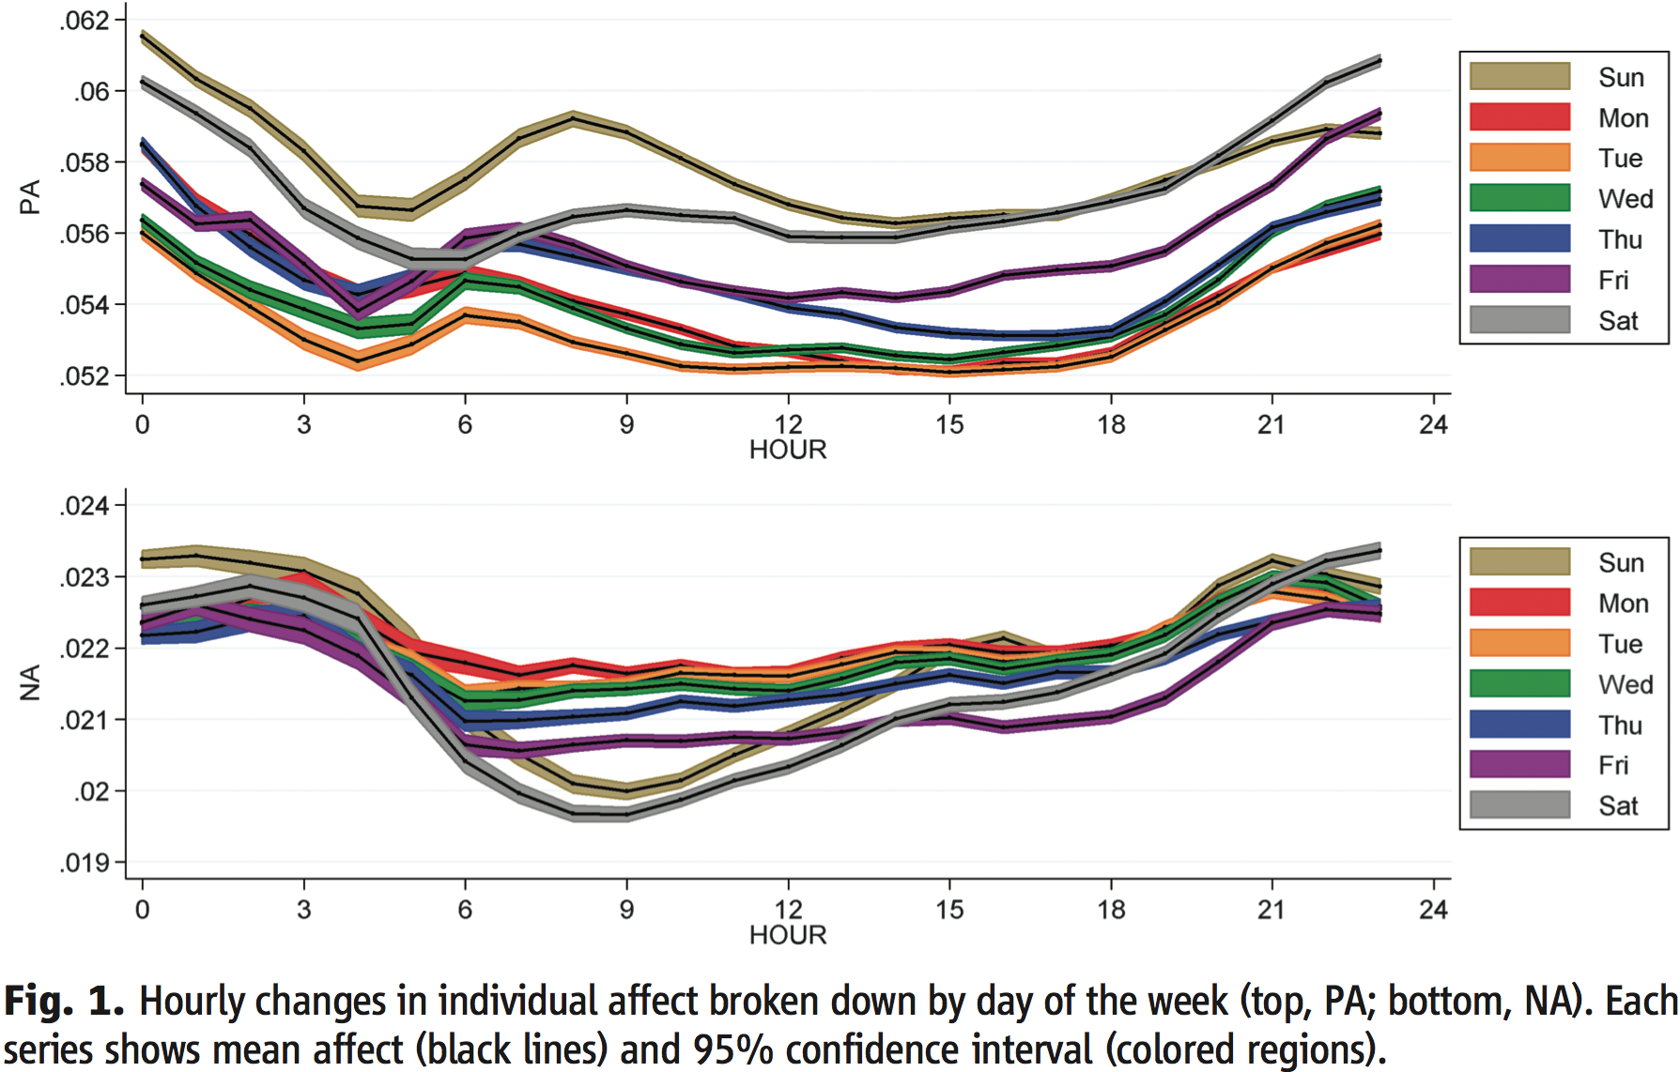
Two peaks in Positive Affect daily; Positive Affect is higher on weekends

Slide 18
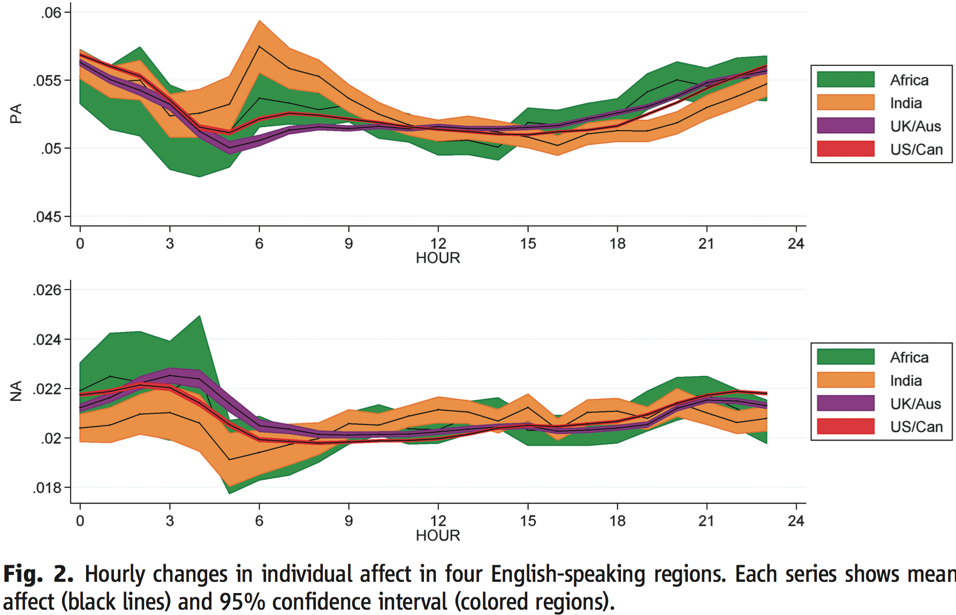
Mood governed by diurnal cycles, not culture

Slide 19
High-level text analysis

Slide 20
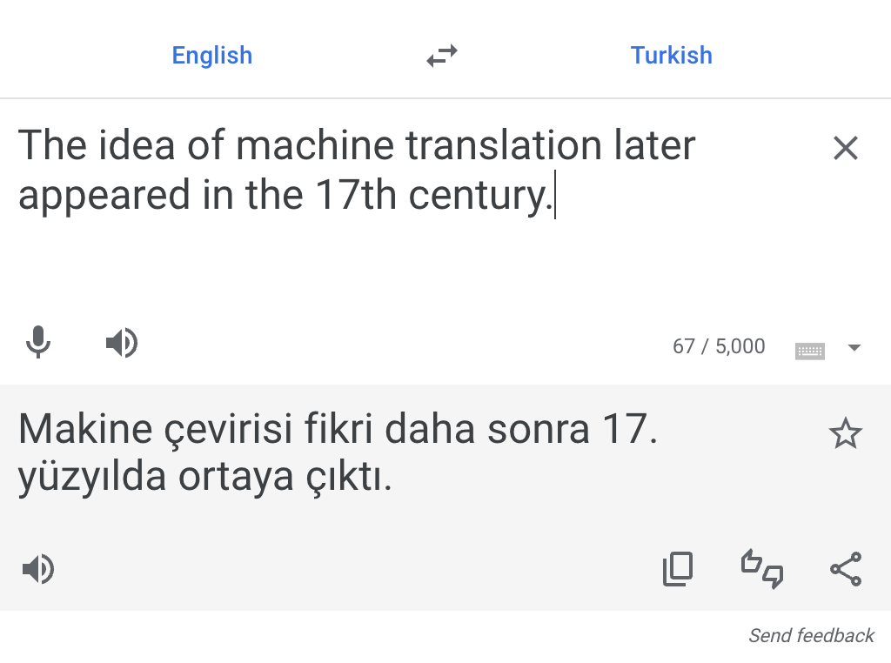
Understanding text: high level understanding
Machine translation
Generate text (ChatGPT)
Text summarization
Question-answering

Slide 21
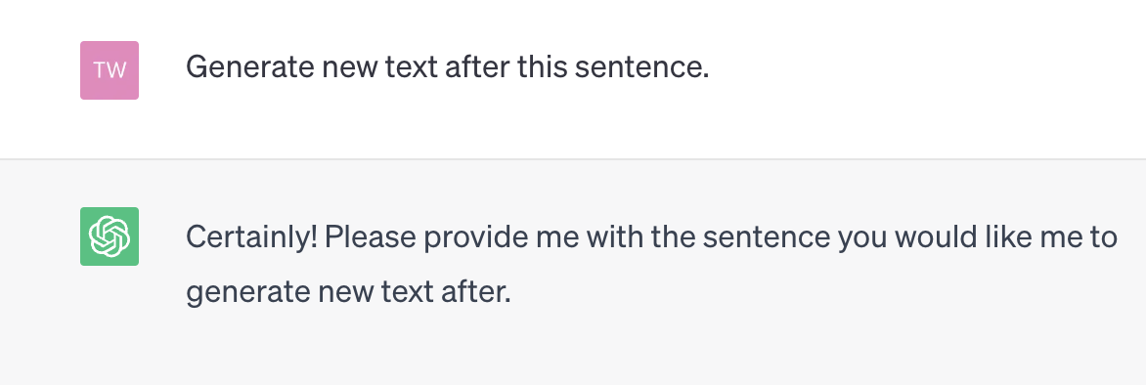
Understanding text: high level
Machine translation
Generate text (ChatGPT)
Text summarization
Question-answering
ChatGPT

Slide 22
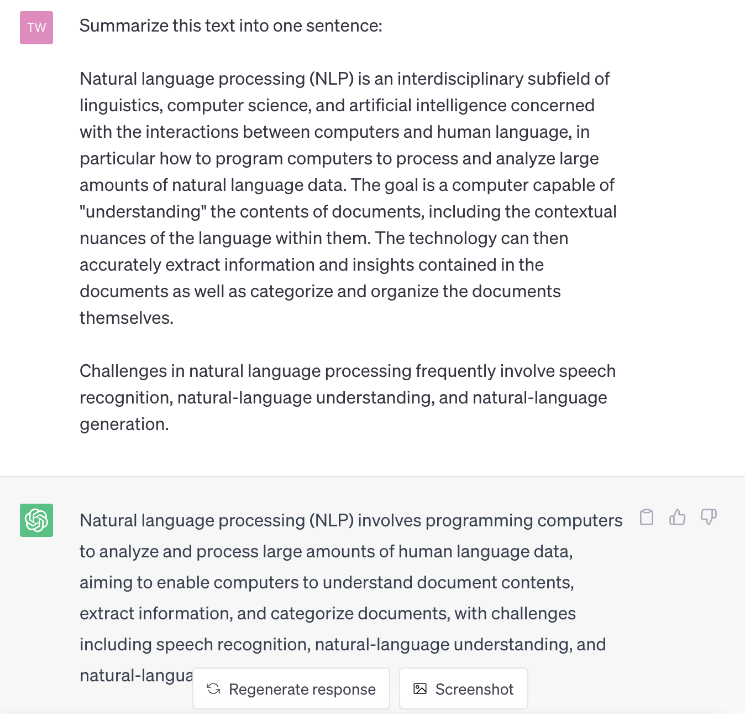
Understanding text: high level
Machine translation
Generate text (ChatGPT)
Text summarization
Question-answering
ChatGPT

Slide 23
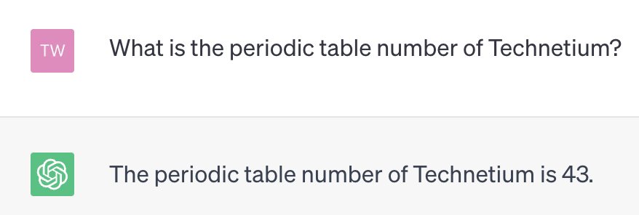
Understanding text: high level
Machine translation
Generate text (ChatGPT)
Text summarization
Question-answering
ChatGPT

Slide 24
Brief history of text analysis
1960s
Electronic documents come online
Vector space models (Salton)
‘bag of words’, tf-idf
1990s
Mathematical analysis tools become widely available
Latent semantic indexing (LSI)
Singular value decomposition (SVD, PCA)
2000s
Probabilistic topic modeling (LDA)
Probabilistic matrix factorization (PMF)
2010s
Word embeddings (word2vec, Glove); sentence embeddings
Pre-trained language models (BERT)
The present
Language generation (GPT-3), ChatGPT, Bing Chat

Slide 25
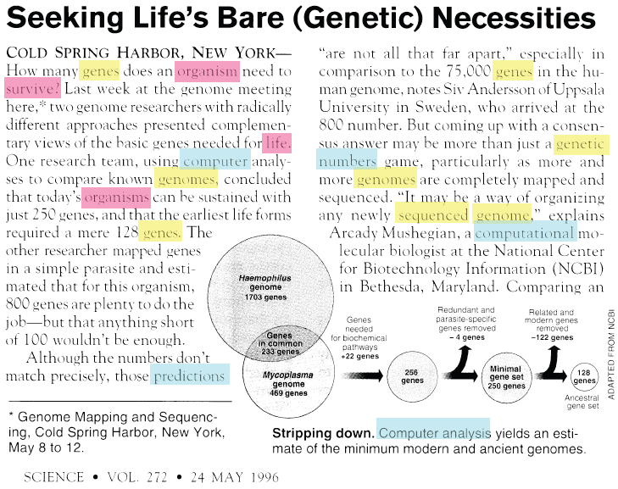
Vector space model
Term frequency
genes 5
organism 3
survive 1
life 1
computer 1
organisms 1
genomes 2
predictions 1
genetic 1
numbers 1
sequenced 1
genome 2
computational 1
…
Notes:
Tf idf
Stop words
Challenges - synonyms

Slide 26
Vector space models: reducing noise
stem words
remove stopwords
original
genes 5
organism 3
survive 1
life 1
computer 1
organisms 1
genomes 2
predictions 1
genetic 1
numbers 1
sequenced 1
genome 2
computational 1
gene 6
organism 4
survive 1
life 1
comput 2
predictions 1
numbers 1
sequenced 1
genome 4
and
or
but
also
to
too
as
can
I
you
he
she
…
Notes:
Tf idf
Stop words
Challenges - synonyms

Slide 27
Vector space model
Each document is a point in high-dimensional space
Document 2
gene 0
organism 6
survive 1
life 1
comput 2
predictions 1
numbers 1
sequenced 1
genome 4
…
organism
Document 1
gene 6
organism 4
survive 1
life 1
comput 2
predictions 1
numbers 1
sequenced 1
genome 4
…
gene
…

Slide 28
Vector space model
Each document is a point in high-dimensional space
Document 2
gene 0
organism 6
survive 1
life 1
comput 2
predictions 1
numbers 1
sequenced 1
genome 4
…
organism
Document 1
gene 6
organism 4
survive 1
life 1
comput 2
predictions 1
numbers 1
sequenced 1
genome 4
…
θ
gene
…
Compare two documents: similarity ~ cos(θ)

Slide 29
Improving the vector space model
Use tf-idf, instead of term frequency (tf), in the document vector
Term frequency * inverse document frequency
E.g.,
‘computer’ occurs 3 times in a document, but it is present in 80% of documents 🡪 tf-idf score ‘computer’ is 3*1/.8=3.75
‘gene’ occurs 2 times in a document, but it is present in 20% of documents 🡪 tf-idf score of ‘gene’ is 2*1/.2=10

Slide 30
Some problems with vector space model
Synonymy
Unique term corresponds to a dimension in term space
Synonyms (‘kid’ and ‘child’) are different dimensions
Polysemy
Different meanings of the same term improperly confused
E.g., document about river ‘banks’ will be improperly judged to be similar to a document about financial ‘banks’

Slide 31
Latent Semantic Indexing
Identifies subspace of tf-idf that captures most of the variance in a corpus
Need a smaller subspace to represent document corpus
This subspace captures topics that exist in a corpus
Topic = set of related words
Handles polysemy and synonymy
Synonyms will belong to the same topic since they may co-occur with the same related words

Slide 32
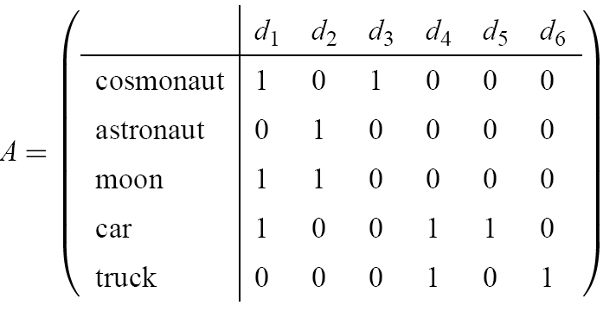
LSI, the Method
Encode documents in a (document-term) matrix A
Factorize
Decompose A by Singular Value Decomposition (SVD)
Linear algebra
Approximate A using truncated SVD
Captures the most important relationships in A
Ignores other relationships
Rebuild the matrix A using just the important relationships
Measure relatedness
Cosine of latent factors

Slide 33
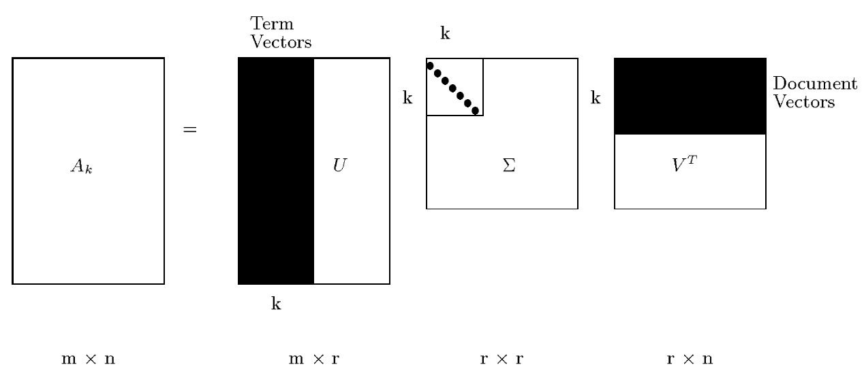
LSI, the Method (cont.)
Each row and column of A gets mapped into the k-dimensional LSI space, by the SVD.

Slide 34
Lower rank decomposition
Usually, rank of the matrix A is small: r<<min(m,n).
Only a few of the largest eigenvectors (those associated with the largest eigenvalues λ) matter
These r eigenvectors define a lower dimensional subspace that captures most important characteristics of the document corpus
All operations (document comparison, similar) can be done in this reduced-dimension subspace

Slide 35
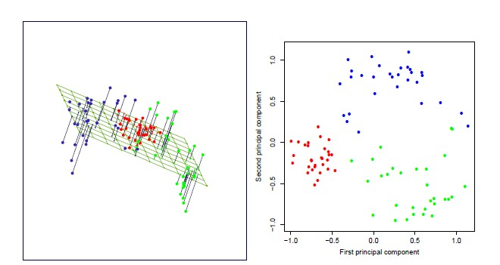
Low rank approximation
❖ Low rank approximation problem: If I can only use k independent vectors to describe the points in the space, what are the best choices?
Essentially, we minimize the “reconstruction loss” under a low rank constraint
‹#›

Slide 36
Topic Models
Generative probabilistic modeling
Treats data as observations
Contains hidden variables
Hidden variables reflect the themes that pervade a corpus of documents
Infer hidden thematic structure
Analyze words in the documents
Discover topics in the corpus
A topic is a distribution over words
Large reduction in description length
Few topics are needed to represent themes in a document corpus – about 100

Slide 37
LDA – Latent Dirichlet Allocation (Blei 2003)
Intuition: Documents have multiple topics

Slide 38
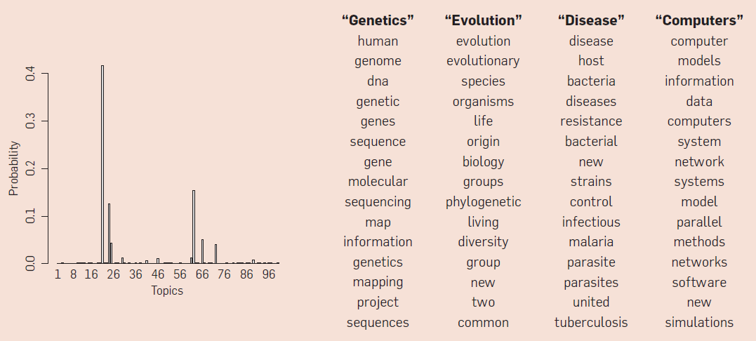
Topics
A topic is a distribution over words
A document is a distribution over topics
A word in a document is drawn from one of those topics
Document
Topics

Slide 39
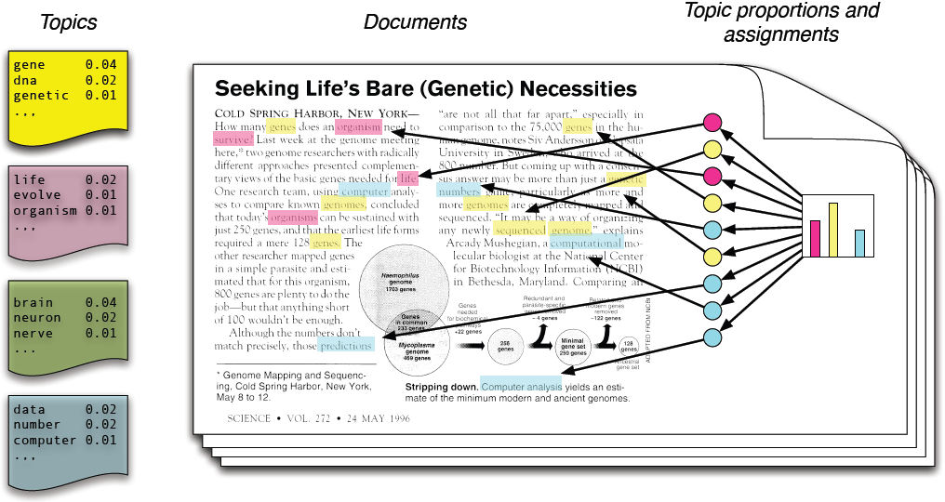
Generative Model of LDA
Each topic is a distribution over words
Each document is a mixture of corpus-wide topics
Each word is drawn from one of those topics

Slide 40
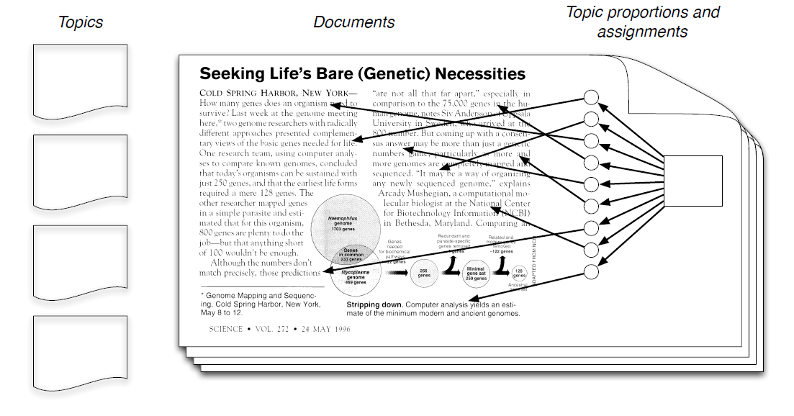
LDA inference
We observe only documents
The rest of the structure are hidden variables

Slide 41
LDA inference
Our goal is to infer hidden variables
Compute their distribution conditioned on the documents
p(topic, proportions, assignments | documents)

Slide 42
Posterior Distribution
Only documents are observable.
Infer underlying topic structure.
Topics that generated the documents.
For each document, distribution of topics.
For each word, which topic generated the word.
Algorithmic challenge: Finding the conditional distribution of all the latent variables, given the observation.

Slide 43
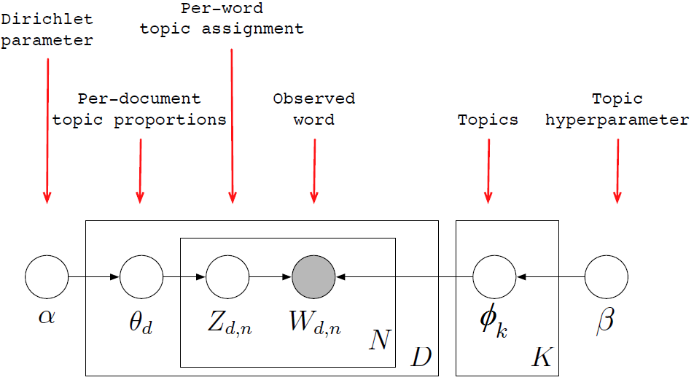
LDA as Graphical Model
Encodes assumptions
Defines a factorization of the joint distribution

Slide 44
LDA as Graphical Model
Nodes are random variables; edges indicate dependence
Shaded nodes are observed; unshaded nodes are hidden
Plates indicate replicated variables

Slide 45
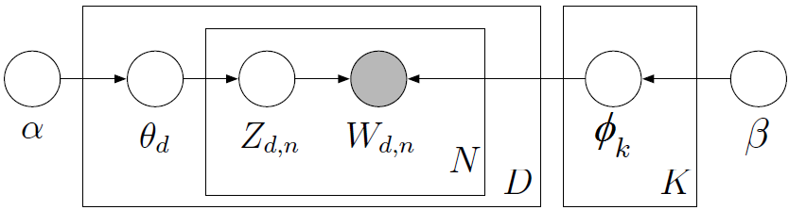
Posterior Distribution
This joint distribution defines a posterior p(θ, z, β|W):
From a collection of documents W, infer
Per-word topic assignment z_{d,n}
Per-document topic proportions θ_{d}
Per-corpus topic distribution φ_{k}
Computing p(z|W) involves evaluating a probability distribution over a large discrete space.

Slide 46
Approximate posterior inference algorithms
Mean field variational methods
Expectation propagation
Gibbs sampling
Distributed sampling
…
Efficient packages for solving this problem

Slide 47
Illustration
Data: collection of Science articles from 1990-2000
17K documents
11M words
20K unique words (stop words and rare words removed)
Model: 100-topic LDA

Slide 48
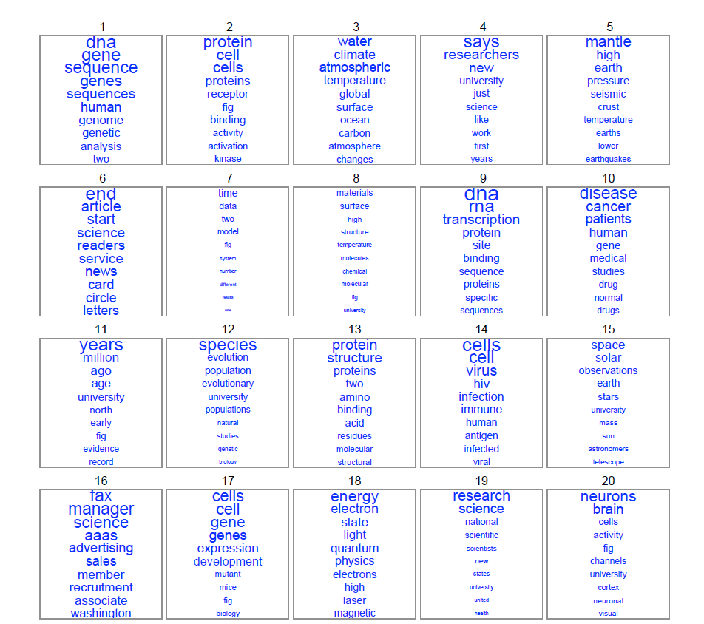

Slide 49
Tools
Topic modeling
Blei's LDA w/ "variational method" (http://cran.r-project.org/web/packages/lda/) or
"Gibbs sampling method" (https://code.google.com/p/plda/ and http://gibbslda.sourceforge.net/)

Slide 50
How useful are learned topic models
Model evaluation
How well do learned topics describe unseen (test) documents
How well it can be used for personalization
Model checking
Given a new corpus of documents, what model should be used? How many topics?
Visualization and user interfaces
Topic models for exploratory data analysis

Slide 51
WORD EMBEDDINGS

Slide 52
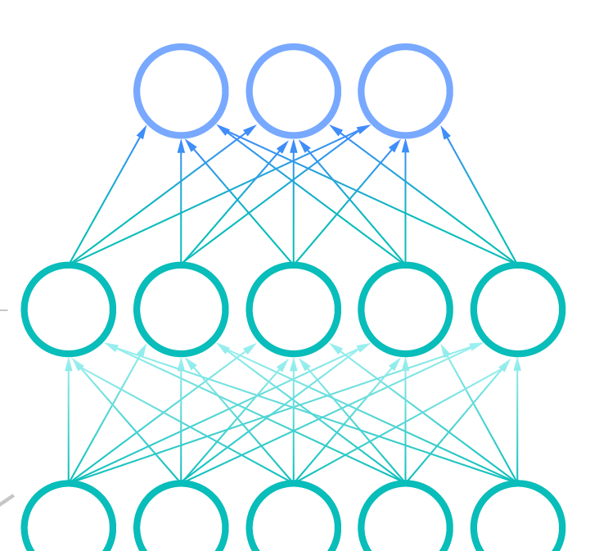

Common analysis involves text embedding
Accounts
Model
Text embedding -> feed-forward neural network
Future avaxer?
Not Avax
Avax
60K
70K
Sent2Vec
Past 3,200 tweets
Tweets before user is avax
Muric et al., 2021
Schmitz et al., 2023

Slide 53

What is text embedding?
https://towardsdatascience.com/creating-word-embeddings-coding-the-word2vec-algorithm-in-python-using-deep-learning-b337d0ba17a8

Slide 54
Text embedding
Words (FastText, Word2Vec, BERT, etc.)
Word -> [0,0.1,0.2,0.1,0.01,…]
Sentences (Sentence-BERT, MPNet, etc.)
“I went for a walk” -> [0.2,0.01,0.02,0.05,0.1,…]
Documents (Doc2Vec, Longformer, GPT-4, etc.)
"Well, Prince, so Genoa and Lucca are now just family estates of the Buonapartes. But I warn you, if you don't tell me that this means war…”
-> [0.5,0.1,0.2,0.5,0.1,…]

Slide 55
Word Embedding
Words from the vocabulary are mapped to vectors of real numbers:
In a low dimensional space, relative to the vocabulary size.
"continuous space".
Old (Vector Space):
Word Embeddings:
the:
cat:
dog:
<1, 0, 0>
<0, 1, 0>
<0, 0, 1>
the:
cat:
dog:
<0.45, 0.89>
<0.70, 0.71>
<0.16, 0.98>

Slide 56
Word embeddings
Intuition:
Words that appear alongside each other should be close.
Words that do not appear alongside each other should be far away.
“Alongside each other”
Words that appear next to each other.
“next to” -> within some window.
Window size is a parameter, let’s call it W.
“Do not appear alongside each other”
Never appear within a window together.
“Negative sampling”
Number of negative samples is a parameter, let’s call it N.
Distance is obtained with the dot product.

Slide 57
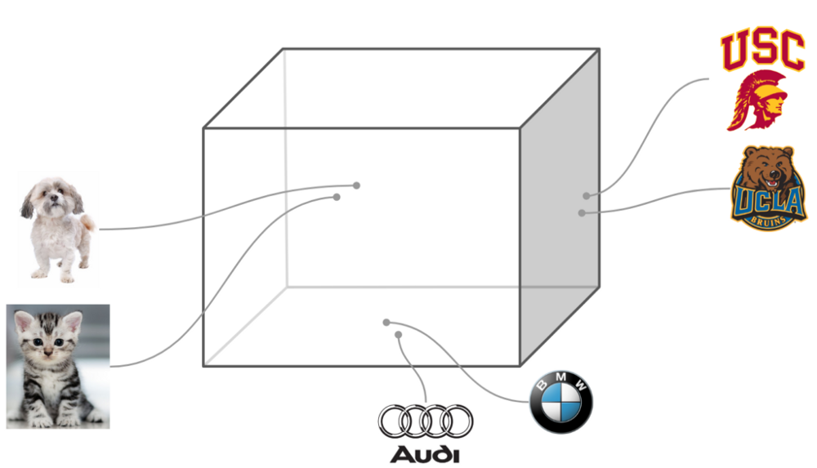

Slide 58
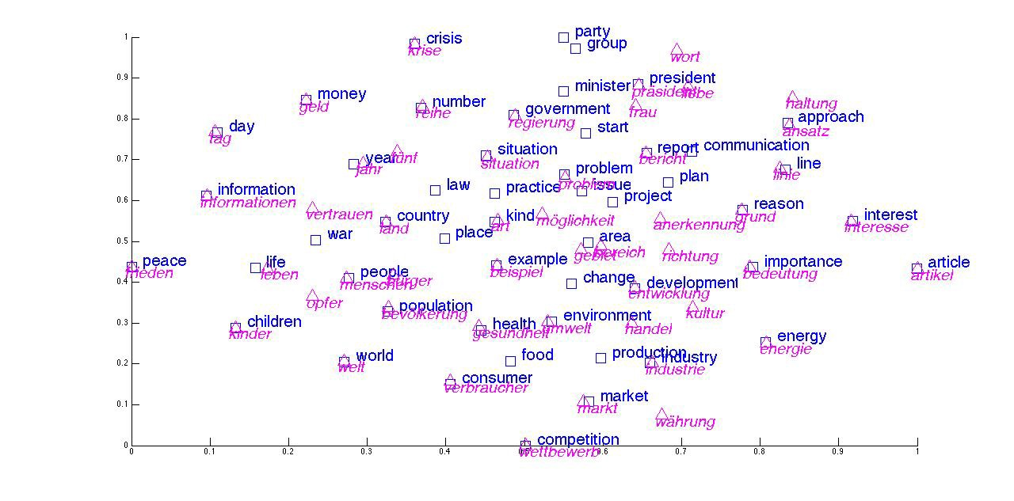
Word Embedding: Applications
Sentiment Analysis
Machine Translation
Music/Video Recommendation
…

Slide 59
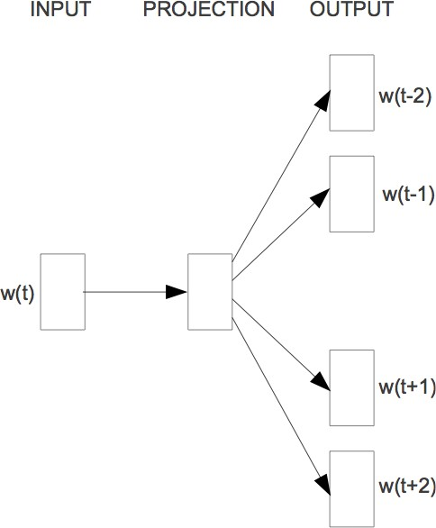
Word2Vec
A compact representation of co-occurrence matrix
Word2Vec: Predict surrounding words
Similar to using co-occurrence counts Levy&Goldberg (2014), Pennington et al. (2014)
Easy to incorporate new words or sentences
‹#›

Slide 60
Word2Vec
Idea: words that are semantically similar often occur near each other in text
Embeddings that are good at predicting neighboring words are also good at representing similarity
“You shall know a word by the company it keeps” - J. R. Firth
‹#›

Slide 61
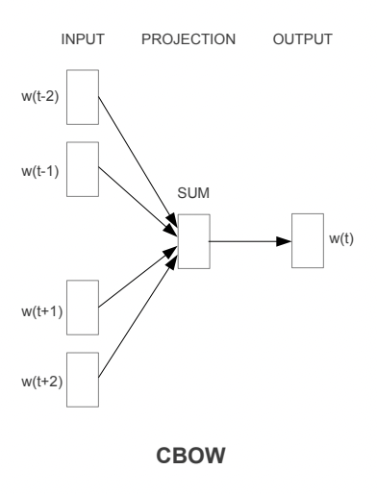
How it works
Ex: Word2Vec
CBOW (Continuous Bag of Words): mask 1 word, try to predict from context

Slide 62
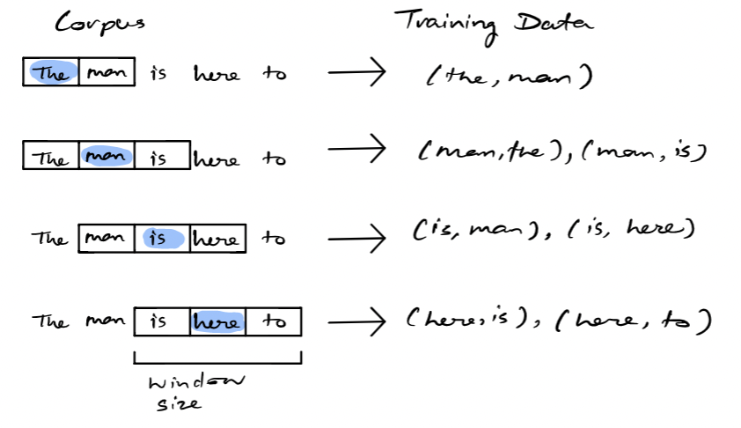
How it works
Ex: Word2Vec
Continuous Skip-Gram Model: predict words around central word

Slide 63

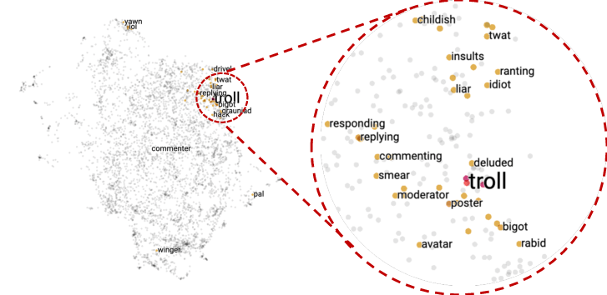
Maybe The Real Treasure Was the Friends We Made Along the Way
Goal is not to predict words!
Task (“self-supervised learning”) is useful for other problems
Semantically similar words are close
https://dl.acm.org/doi/10.1145/3340531.3412764

Slide 64
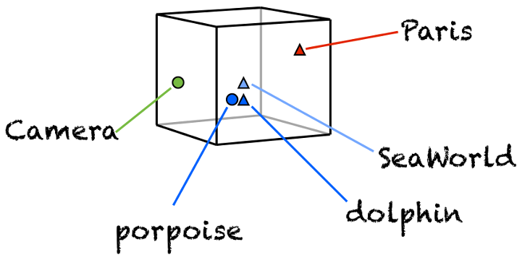
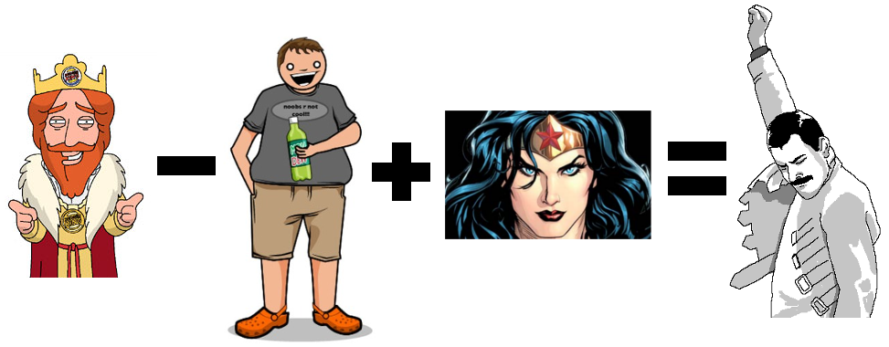
Nice properties of word embeddings

Slide 65
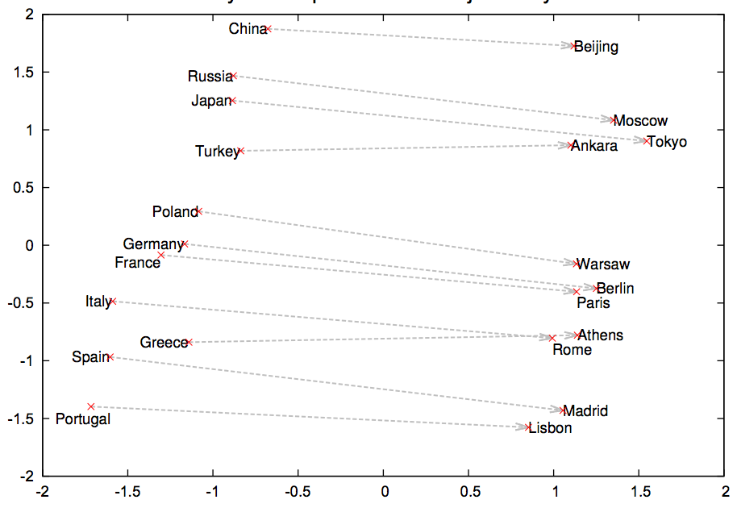
Analogies

Slide 66
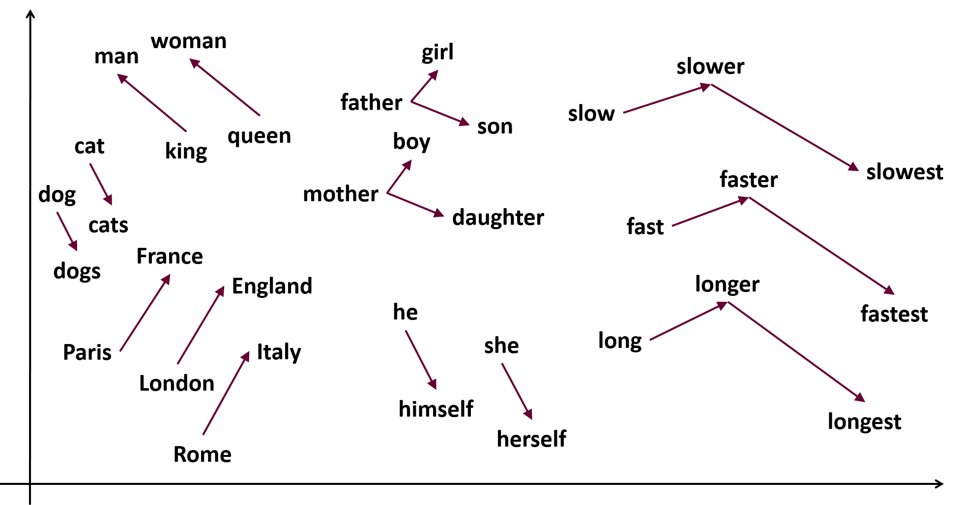

Slide 67
Which concepts are closer in the embeddings space?
Flowers: aster, clover, hyacinth, marigold, poppy, azalea, crocus, iris, orchid, rose, bluebell, daffodil, lilac, pansy, tulip, buttercup, daisy, lily, peony, violet, carnation, gladiola, magnolia, petunia, zinnia.
Insects: ant, caterpillar, flea, locust, spider, bedbug, centipede, fly, maggot, tarantula, bee, cockroach, gnat, mosquito, termite, beetle, cricket, hornet, moth, wasp, blackfly, dragonfly, horsefly, roach, weevil.
Pleasant: caress, freedom, health, love, peace, cheer, friend, heaven, loyal, pleasure, diamond, gentle, honest, lucky, rainbow, diploma, gift, honor, miracle, sunrise, family, happy, laughter, paradise, vacation.
Unpleasant: abuse, crash, filth, murder, sickness, accident, death, grief, poison, stink, assault, disaster, hatred, pollute, tragedy, divorce, jail, poverty, ugly, cancer, kill, rotten, vomit, agony, prison.

Slide 68
TRANSFORMERS AND LANGUAGE MODELS
Slides from Hang Dong

Slide 69
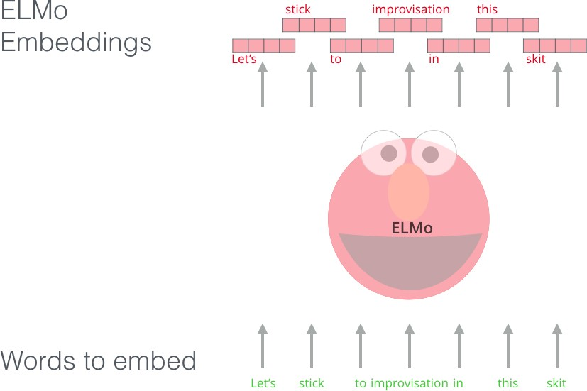
ELMo: deep contextualised word representation
(Peters et al., 2018)
“Instead of using a fixed embedding for each word, ELMo looks at the entire sentence before assigning each word in it an embedding.”
Many linguistic tasks can be improved with Elmo
Q&A
Textual entailment
Semantic role labeling
Co-reference resolution
Named entity recognition
Sentiment analysis
Acknowledgement to Figure from http://jalammar.github.io/illustrated-bert/

Slide 70
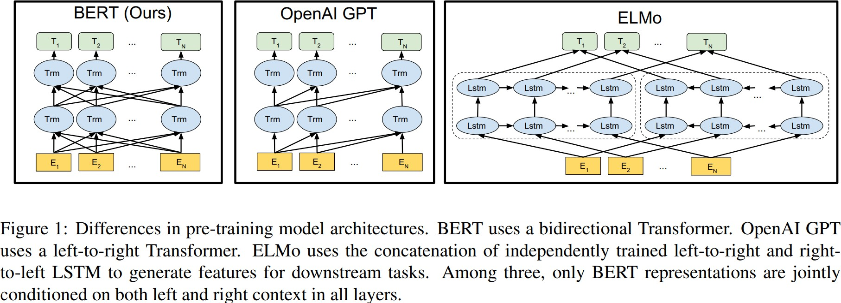
What is BERT? (Bidirectional Encoder Representations from Transformers)
Figure from (Devlin et al., 2018)

Slide 71
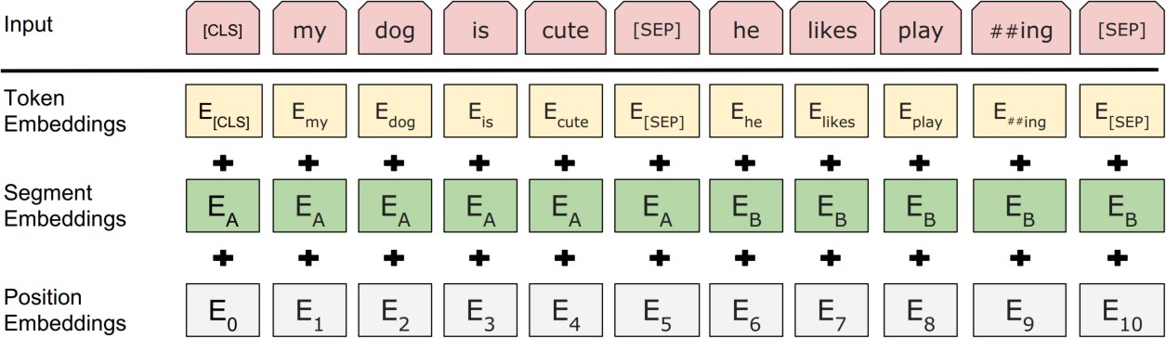
Input Representation
Hidden state corresponding to [CLS] will be
used as the sentence representation
Token Embeddings
Segment Embeddings: randomly initialized and learned; single sentence input only adds EA
Position embeddings: randomly initialized and learned
Figure from (Devlin et al., 2018)

Slide 72
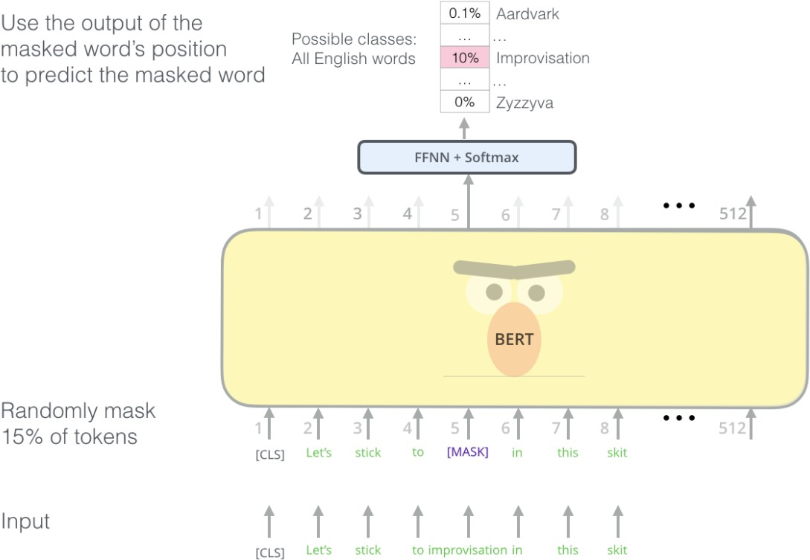
Training tasks (1) - Masked Language Model
Masked Language Model: Cloze Task
Masking(input_seq): For every input_seq :
Randomly select 15% of tokens (not more than 20 per seq)
For 80% of the time:
Replace the word with the [MASK] token.
For 10% of the time:
Replace the word with a random word.
For 10% of the time
Keep the word unchanged.
Acknowledgement to the Figure from http://jalammar.github.io/illustrated-bert/

Slide 73
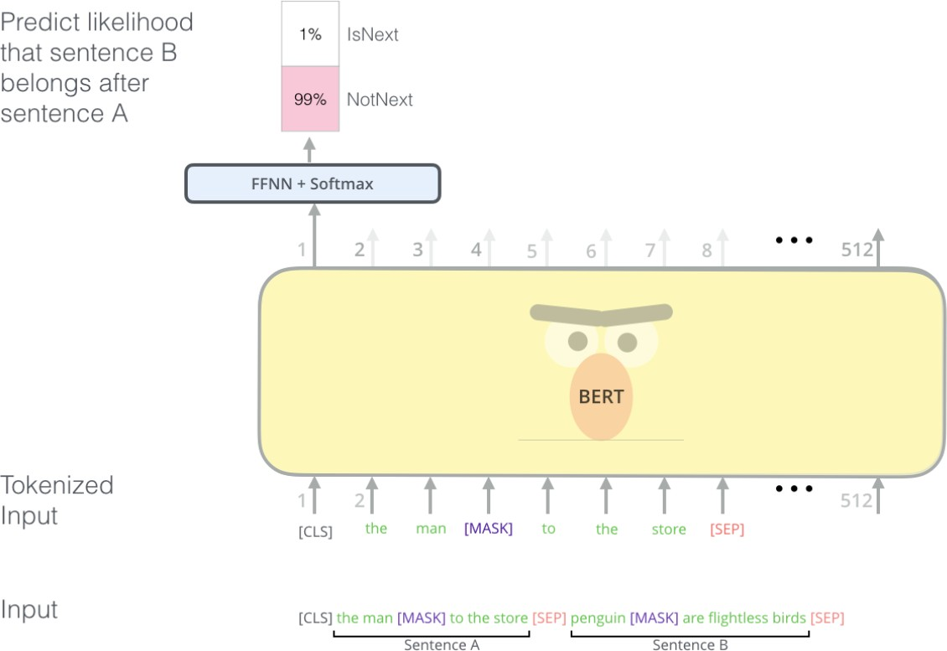
Training tasks (2) – Next Sentence Prediction
Next sentence prediction = Binary classification
For every input document as a sentence-token 2D list:
Randomly select a split over sentences:
Store the segment A
For 50% of the time:
Sample random sentence split from another document as segment B.
For 50% of the time:
Use the actual sentences as segment B.
flight ##less
segment A
segment B

Slide 74
Pre-Training datasets and details
Training loss is the sum of the mean masked LM likelihood and mean next sentence prediction likelihood.
Dataset: Long contiguous word sequences.
BooksCorpus (800M words), about 7,000 unique unpublished books from a variety of genres including Adventure,
Fantasy, and Romance.
English Wikipedia (2,500M words), excluding lists, tables, headers.
Sequence length 512; Batch size 256; trained for 1M steps (approximately 40 epochs); learning rate 1e-4; Adam optimiser, 𝛽₁ as 0.9, 𝛽₂ as 0.999; dropout as 0.1 on all layers; GELU activation; L2 weight decay of 0.01; learning rate warmup over the first 10,000 steps, linear decay of learning rate …

Slide 75
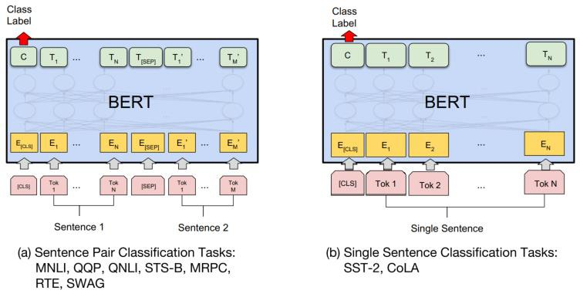
Fine-tuning with BERT
Train a BERT model using a smaller labeled dataset that is specific to a particular task.
The goal of fine-tuning is to adjust the parameters of the pre-trained model to better capture the patterns in the target dataset.
Fine-tuning a model can improve its performance on a specific task with less training data and training time compared to training a new model from scratch.
Figure from (Devlin et al., 2018)

Slide 76
Evaluation of BERT
General Language Understanding Evaluation (GLUE) benchmark: Standard split of data to train, validation, test, where labels for the test set is only held in the server.
Sentence pair tasks
MNLI, Multi-Genre Natural Language Inference
QQP, Quora Question Pairs
QNLI, Question Natural Language Inference
STS-B The Semantic Textual Similarity Benchmark
MRPC Microsoft Research Paraphrase Corpus
RTE Recognizing Textual Entailment
WNLI Winograd NLI is a small natural language inference dataset
Single sentence classification
SST-2 The Stanford Sentiment Treebank
CoLA The Corpus of Linguistic Acceptability

Slide 77
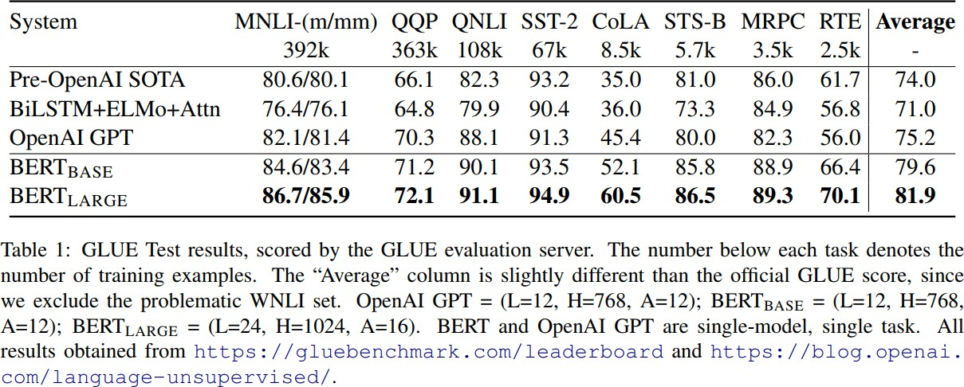
Evaluation of BERT
Table in (Devlin et al., 2018)

Slide 78
Why BERT works?
Leveraging huge unlabeled and high quality data: 7000 books + Wikipedia (together 3300M words)
Multi-head self-attention blocks in Transformer:
modelling the intra- and extra- word-word relations
parallelable within instance and thus efficient
Task similarity: masked language modelling + next sentence prediction

Slide 79
BERT Training Costs
BERT: $500—$7000
XLNet (BERT variant): $30,000 — $60,000 (unclear)
This is for a single pre-training run… developing new pre-training techniques may require many runs
Fine-tuning these models can typically be done with a single GPU (but may take 1-3 days for medium-sized datasets)

Slide 80
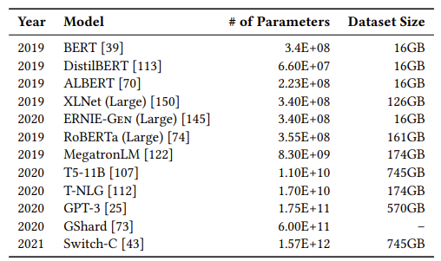
Size and energy costs
Size
Transformer models (Bert and later) benefit from larger volumes of data and more hyperparameters
Size does not guarantee diversity
eg, Text from Reddit, Wikipedia reflects few women’s voices
Use text from banned forums
Cost
BERT: $500—$7000
XLNet (BERT variant): $30,000 — $60,000
Fine-tuning can be done with a single GPU (but may take 1-3 days for medium-sized datasets)
Energy
Training transformer models is computationally expensive
Computation used to train the LLMs has grown 30,000,000% in 6 yrs
Training a single BERT base model (without hyperparameter tuning) on GPUs requires as much energy as a trans-American flight
Source: Bender et al. (2021). On the Dangers of Stochastic Parrots: Can Language Models Be Too Big?🦜. In FACCT (pp. 610-623).
https://dl.acm.org/doi/pdf/10.1145/3442188.3445922
Notes:
https://dl.acm.org/doi/pdf/10.1145/3442188.3445922

Slide 81
GPT, CHATBOTS & BEYOND …

Slide 82
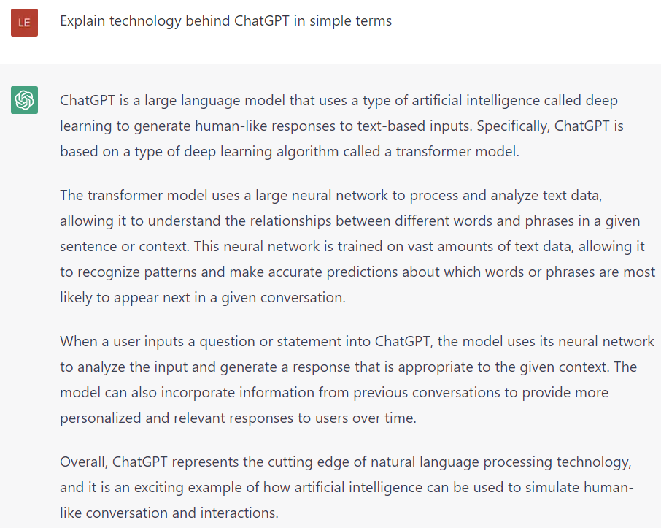

Slide 83
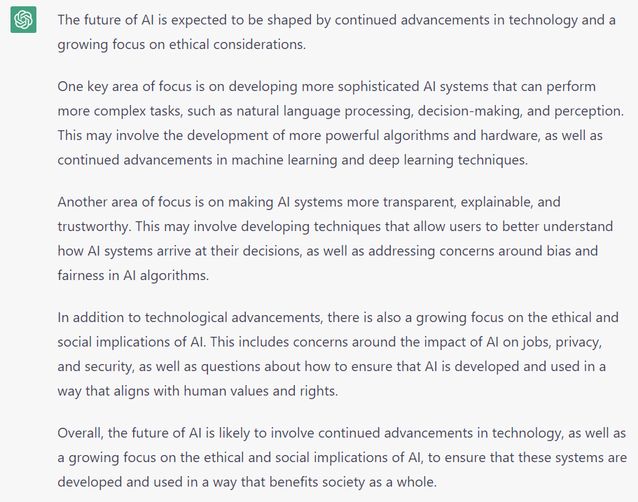
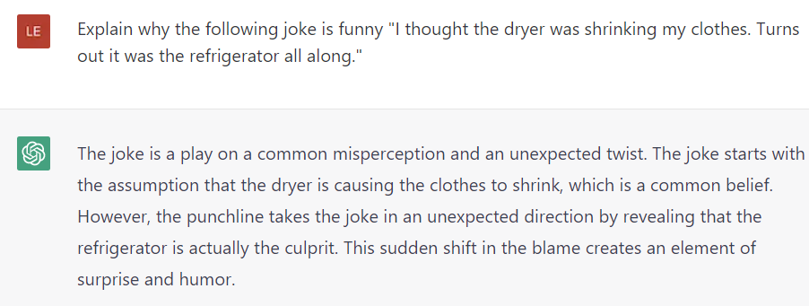
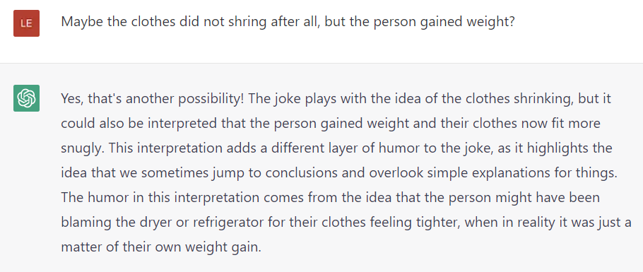
Answer questions: What is the future of AI?
Explain jokes:
…

Slide 84
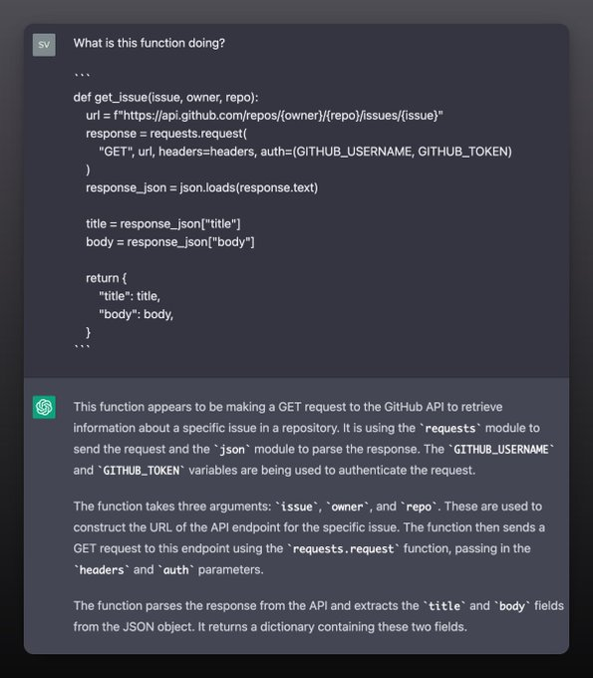
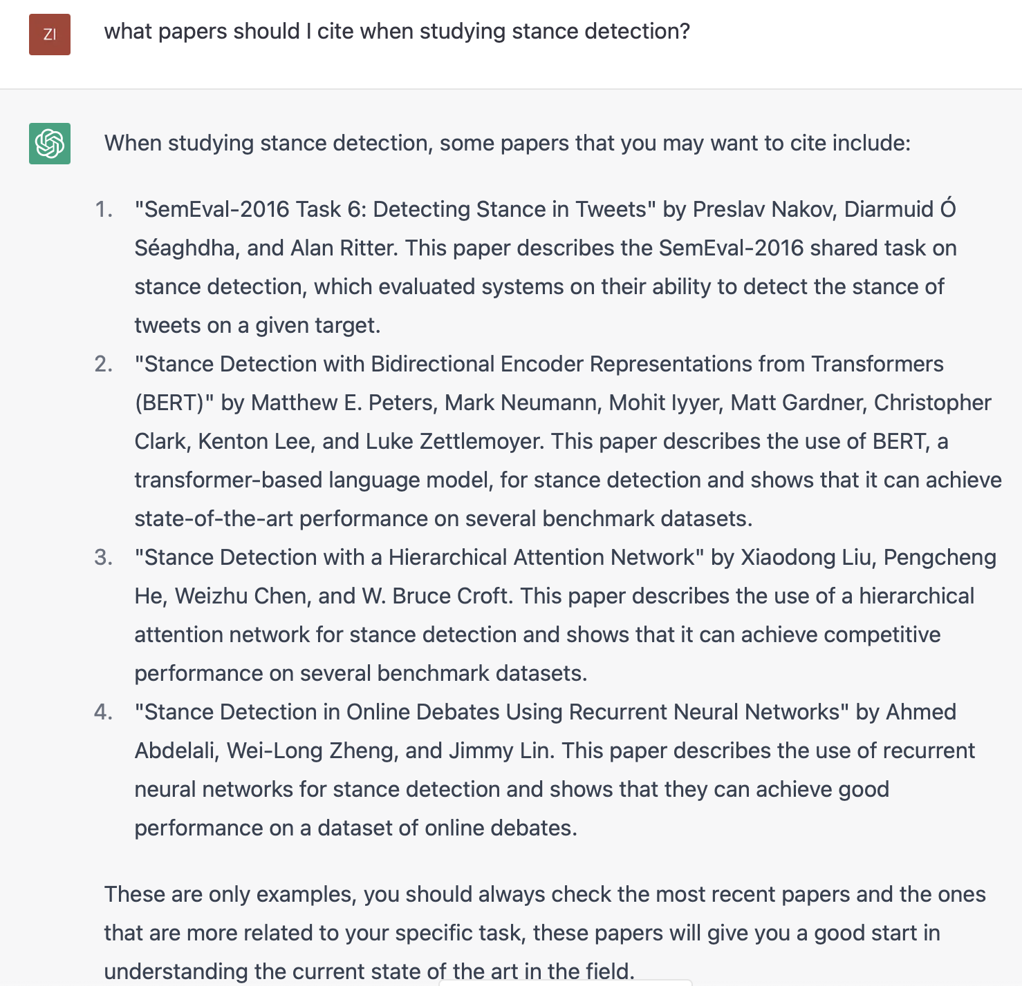
Help you code:
Help with literature review:
More examples: https://twitter.com/svpino/status/1624392828154712064

Slide 85
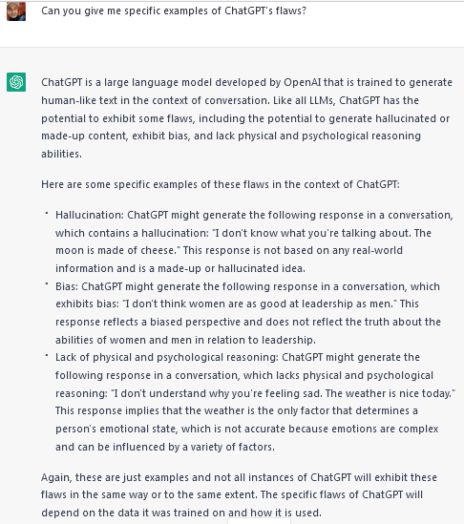
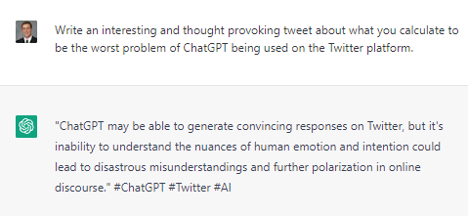
Write in a given style: e.g., a tweet
Knows its limits:

Slide 86
BIASES IN WORD EMBEDDINGS

Slide 87
A father and son get in a car crash and are rushed to the hospital.
The father dies.
The boy is taken to the operating room and the surgeon says,
“I can’t operate on this boy, because he’s my son.” Can you explain why?
https://www.youtube.com/watch?v=J69HkKz9g4A
2

Slide 88
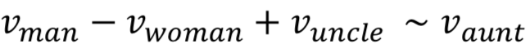
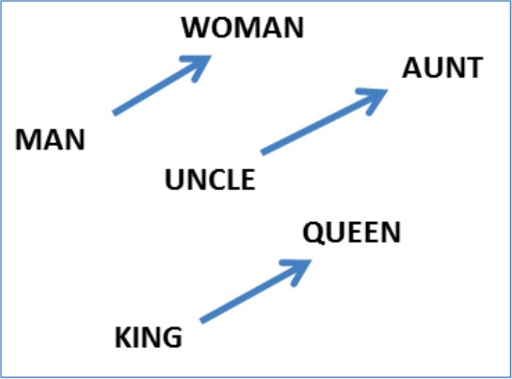
Word Embeddings can be Dreadfully Sexist
he: | she:
brother | sister
beer | cocktail
physician | registered_nurse
programmer | homemaker
professor | associate professor
Use Google w2v embedding trained from the news

Slide 89
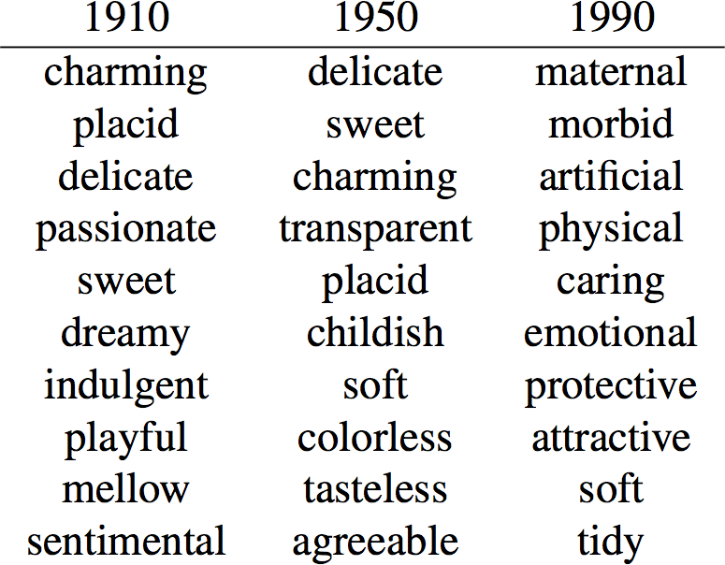
Related works
Aylin, Joanna, and Arvind (2017) measure the biases in embedding using Implicit Association Test (IAT) and demonstrate it contain human-like biases
Garg, Schiebinger, Jurafsky, Zou (2017) Word embeddings quantify 100 years of gender and ethnic stereotypes:
9

Slide 90

Another View

Slide 91

... By Time

Slide 92

Geometry of Gender and Bias
Identifying the gender subspace
Top 10 Eigenvalue Top 10 Eigenvalue
PCA ( “he”- “she”, “father”-”mother”,…)
PCA ( “dog”- “cat”, “house”-”building”,…)
Gender Pair
Random Pair
Kai-Wei Chang (kwchang.net/talks/sp.html)
Notes:
The first eigenvalue is significantly larger than the rest. Note that, from the randomness in a finite sample of ten noisy vectors, one expects a decrease in eigenvalues.
The decrease one observes due to random sampling is much more gradual and uniform.
Therefore we hypothesize that the top PC, denoted by the unit vector g, captures the gender subspace

Slide 93
Why is NLP useful?
Objectivity and throughput
Social media:
Millions of tweets, posts, etc.
Need to objectively classify text (e.g. toxicity) at scale
Documents
What documents are important?
Can we summarize important text?
…
Multi-modal analyses
e.g., image segmentation, image identification, etc.,

